Slide 1


SQL Safari Gamified Learning for SQL
A new way to learn databases
Student ID – st20328096– KD/BSCSD/19/05
Name: Galketihenege Krishan Chamara Abeywardhana
Notes:
Good morning dear lecturers
I am Krishan Abeywardhana.
Today, I will walk you through my final project “SQL Safari”
It is a gamified learning platform for learning SQL.

Slide 2

Content
Why SQL?
Current Problem?
Gamified Learning?
Adaptive Difficulty?
Traditional vs Gamified Learning.
What’s SQL Safari?
Technology Stack
Future Improvements
Notes:
During this presentation, I will talk about,
Why SQL?
Current Problem?
Gamified Learning?
Adaptive Difficulty?
Traditional vs Gamified Learning.
What’s SQL Safari?
Technology Stack
and
Future Improvements

Slide 3

Why SQL?
SQL is the language of databases.
Used in many field.
Essential for data analysis.
Notes:
SQL is essential because it enables
efficient storage,
retrieval, and management of data. Today, SQL powers everything from
business analytics,
financial systems,
web applications and AI-driven decision-making.

Slide 4

Current Problem
Students find learning SQL is boring.
Notes:
SQL often feels strange, with commands that don’t immediately connect to real-life situations.
A new learner must remember a set of SQL keywords to begin.

Slide 5

Why Gamified Learning?
Learning feels like playing a game.
Increases motivation & engagement.
Notes:
Gamified learning Turns learning into an enjoyable, game-like experience.
It boosts motivation and keeps students actively engaged.

Slide 6
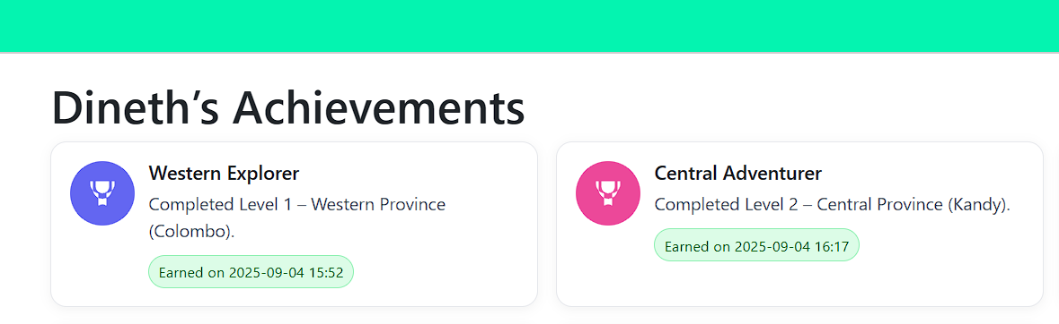
Why Gamified Learning? Contd..
Rewards.
Progress tracking.
Notes:
In gamified learning, the users will get rewards and their progress is tracked. This will make the process more engaging.
Here you can see an example from the SQL Safari.

Slide 7

Adaptive Difficulty
If a student struggles show hints, easier steps.
Game adjust difficulty level by level.
Notes:
The game automatically adjusts difficulty level by level, matching each learner’s progress.
This will make learner feel confident to continue further.

Slide 8
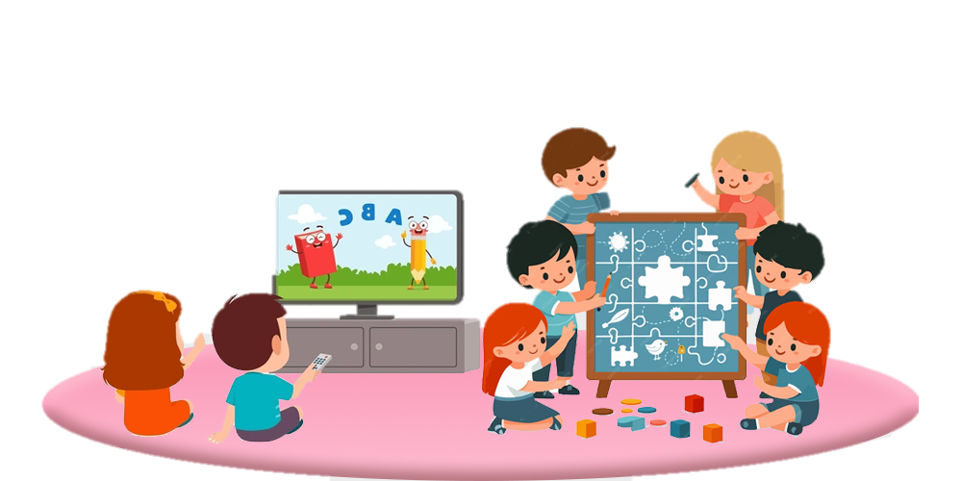

Traditional vs Gamified Learning
Traditional: lectures, fixed exercices, low engagement.
Gamified: story-driven, interactive, rewarding.
Notes:
Traditional learning relies on lectures and fixed exercises, which often result in low engagement.
Gamified learning uses stories, interaction, and rewards to make the process more engaging and enjoyable.

Slide 9


What is SQL Safari?
A narrative-driven game across Sri Lanka’s provinces.
Each province is a level.
Players complete SQL tasks to level up.
Immediate feedback, hints, and achievements.
Notes:
SQL Safari is a narrative-driven game that takes players across Sri Lanka’s provinces, where each province becomes a new level. To advance, players must complete SQL tasks, receiving immediate feedback, helpful hints, and achievements that keep them motivated and engaged.

Slide 10

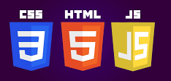
Technology Stack
Backend:
PHP(Laravel)
Frontend:
HTML
CSS
Bootstrap
JS
Database: MySQL.
Notes:
For the frontend, I used HTML, CSS, Bootstrap, and JavaScript to design an interactive interface, while the backend was developed using the Laravel framework to ensure efficiency and scalability.

Slide 11
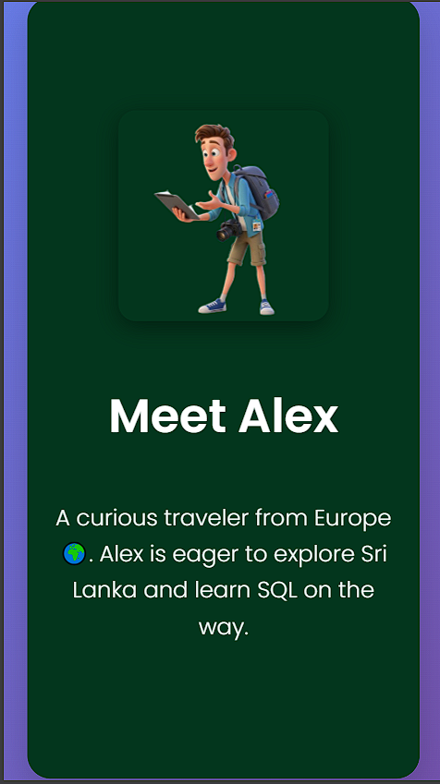
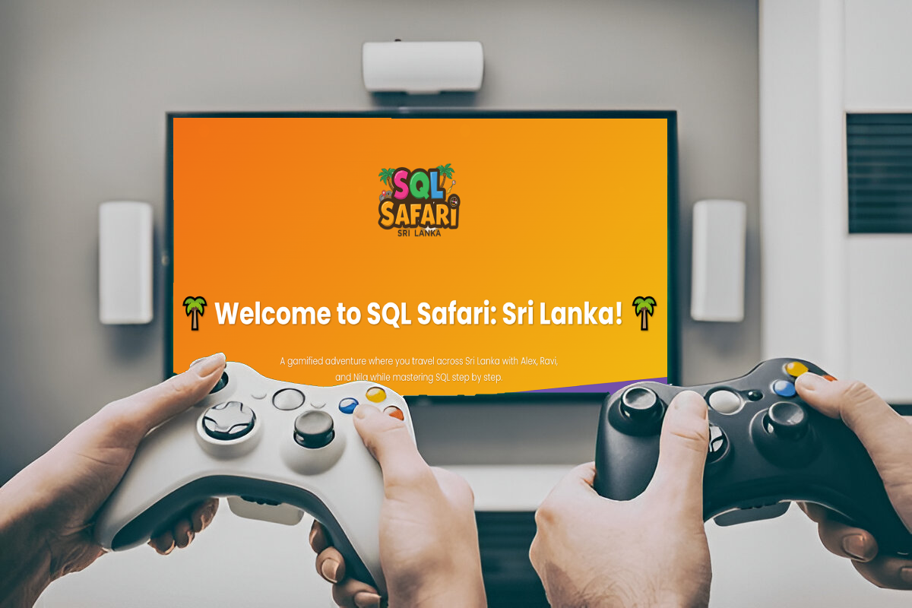
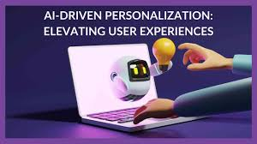
Future Improvements
Multiplayer challenges.
AI-driven personalized hints.
Mobile app version.
Notes:
Future improvements include introducing multiplayer challenges for collaborative and competitive learning, integrating AI-driven personalized hints to support individual learners, and developing a mobile app version to make SQL Safari accessible anytime, anywhere.

Slide 12

Students find learning SQL is boring.
With SQL Safari, learning feels like playing a game.

Slide 13
Thank You
Notes:
If you have any questions, you can ask now.
Now we will move on to the live demonstration.

